Slide 1
End-to-End QA Project: Online Quiz System
M Fahad Bashir
June 2025

Slide 2
Project Overview
• Simple quiz app built in Streamlit
• Features: login, quiz questions, score result
• QA objective: Full lifecycle demo from requirements to automation

Slide 3
QA Process Map
SRS
Requirement Traceability Matrix
Test Plan
Test Cases
Unit Testing
Integration
System Testing
UAT
Automation
CI/CD
Reporting

Slide 4
Linking to Theory (Week 1-3 )
Step | Activity | Week/Day It Connects To
1. Understand Requirements | Prepare SRS + functional requirements | Week 1 – Day 3
2. Traceability Matrix | Map requirements to test cases | Week 1 – Day 3
3. Test Plan | Define scope, risks, test approach | Week 1 – Day 4
4. Test Case Design | EP, BVA, decision tables | Week 1 – Day 5
5. Unit Test | Use pytest for backend | Week 2 – Day 6

Slide 5
Linking to Theory (Week 1-3 )
Step | Activity | Week/Day It Connects To
6. Integration Tests | Combine login + quiz submission | Week 2 – Day 6
7. System Testing | End-to-end flow of quiz-taking | Week 2 – Day 7
8. Acceptance Testing | Define UAT scenarios | Week 2 – Day 7
9. Exploratory Testing | Try edge cases on quiz form | Week 3 – Day 14
10. Automation (Selenium) | Automate login + quiz attempt | Week 3 – Day 11–12

Slide 6
Linking to Theory (Week 1-3 )
Step | Activity | Week/Day It Connects To
11. Defect Logging | Log bugs in JIRA/Excel | Week 2 – Day 9
12. Test Execution Report | Fill results, show dashboard | Week 3 – Day 13
13. CI/CD | Auto-run tests using GitHub Actions | Week 3 – Day 14
14. Final Wrap-up | Demo, bug summary, lessons | Week 3 – Day 15

Slide 7
1. Understand Requirements (SRS + Functional Specs)
Foundational QA step — your goal is to understand what the system should do, and write it clearly in an SRS-like format (Software Requirements Specification
• Functional Requirements (FR1–FR7)
• Non-Functional Requirements (NFR1–NFR4)
• Actors: Student, QA
• Out of scope: Admin, database

Slide 8
2. Traceability Matrix
A Requirement Traceability Matrix (RTM) maps:
Requirements (from SRS)
Related test cases
Defects (if any)
It ensures: "Have we tested every requirement? "If something fails, which requirement does it affect?"

Slide 9
3: Writing the Test Plan
A Test Plan is a document that describes:
What to test
How it will be tested
Who will test it
What resources/tools will be used
When the testing will happen
It helps your team stay organized, focused, and measurable.

Slide 10
4. Test Case Design
Write real test cases based on your SRS and test plan — using techniques like:
Equivalence Partitioning (EP)
Boundary Value Analysis (BVA)
Decision Tables
Manual functional test cases
----
What to Do Next
Fill these test cases in your Excel sheet or TestLink.
Use this :
Manual execution
Test status tracking
Exploratory additions

Slide 11
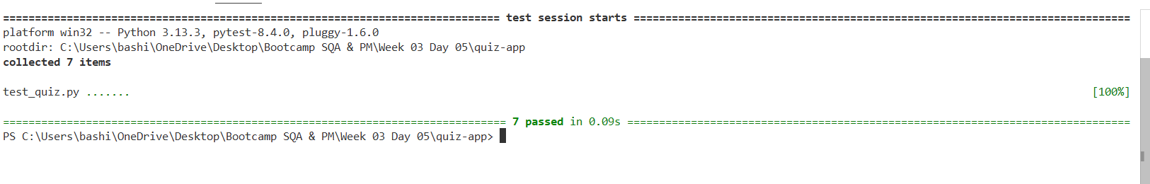
5. Unit Test
This is where we test individual functions (units) of code to make sure they behave as expected.
Writing Unit Tests Using pytest
⚙️ How to Run Unit Tests
Make sure pytest is installed & you run the test :
pip install pytest
pytest test_quiz.py

Slide 12
It’s impact
Benefit | Result
Verifies core logic | grade_quiz() works correctly
Prevents future bugs | If function changes, test will catch it
Enables CI/CD | Can run these tests automatically in GitHub Actions

Slide 13
6. Integration Testing
Test multiple components working together — e.g., login → quiz → grading.
What to Test:
User logs in successfully
Quiz loads after login
Answers are submitted → score is calculated
Result is displayed correctly
Testing : Manual or use some tool

Slide 14
7. System Testing
Test the entire application as a black box, end-to-end
Focus:
UI flow
User experience
Functional correctness
Layout, input, and feedback
Testing
Open app via streamlit run app.py
Try all scenarios:
Valid login
Wrong login
Skip quiz questions
Submit all correct/wrong answers
Observe response time & layout
Record results in execution log.

Slide 15
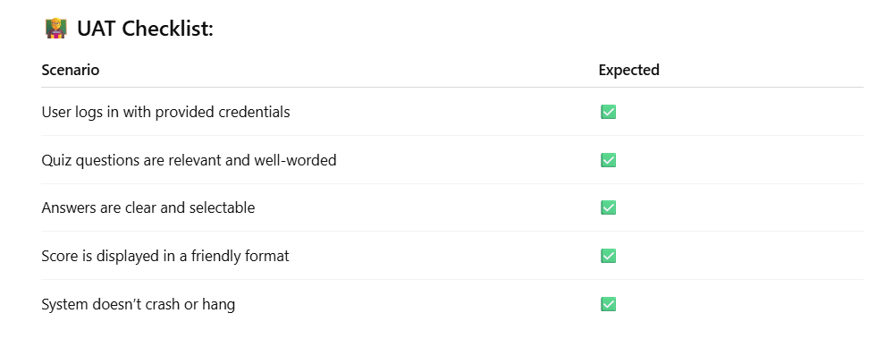
8. Acceptance Testing (UAT)
“Does the app meet user expectations?”
UAT is not just checking logic — it’s validating the business goal: "Can a student easily take a quiz and get results?”

Slide 16
9. Exploratory Testing
You’ve already prepared your app for exploratory testing by:
Adding text fields (name, etc.)
Allowing multiple answer types
Keeping input flexible
What to Test
Test Idea | Why
Submit blank login | Should show error
Enter emojis in answers | App should not break
Enter <script> in name/remarks | No XSS or crash
Try fast double submit | Should not process twice
Copy-paste long Unicode input | Layout should remain stable
Notes:
Document It also

Slide 17
Steps
Steps | Goal | Action
6. Integration Test | Logic + flow works | Login → Quiz → Grade
7. System Test | Full app behavior | End-to-end manual test
8. UAT | User satisfaction | Validate usability
9. Exploratory | Creative edge case hunt | Try to break the app

Slide 18
10: Automation Testing with Selenium
Goal: Simulate user actions (login, answer quiz) automatically. already now let's automate basic flows.
We can automate:
Valid login
Answer selection
Submission
Result validation (advanced: check output)

Slide 19
11: Logging Defects
Track bugs you find in manual/exploratory/system tests.
Use a Bug Log (Excel or Google Sheet)
You can also show a sample defect in JIRA or GitHub Issues
Bug ID | Title | Steps to Reproduce | Expected | Actual | Severity | Status
BUG_01 | Score not shown if quiz skipped | Skip answers → Submit | Show warning | Nothing happens | High | Open
BUG_02 | App crashes on emoji input | Enter 😵 in name | Accept input | App slow | Medium | Open

Slide 20
12. Test Execution Reporting
Summarize results of manual + automation tests.
Use the Excel dashboard we previously created.
Deliverables:
Test log
Bug log
Dashboard
Screenshots

Slide 21
13: Continuous Testing with CI/CD
Ensure every change triggers auto testing
Prepare quiz-test.yml (GitHub Actions)
Each git push:
Triggers pytest
Shows result in GitHub Actions
Can add badges in README

Slide 22
14: Final QA Wrap-Up / Review
Manual testing
Planning
Unit/integration/system testing
Automation
CI/CD
Reporting & wrap-up

Slide 23
Conclusion & Learnings
• Practiced complete QA workflow
• Used industry tools and CI setup
• Understood test planning, design, execution
• Gained confidence for real projects

Slide 24
Thank You / Q&A
Let's discuss or explore anything you’re curious about!

